Slide 1
Statistical Genetics
Lecture 1
Basic Genetics Review / Mendelian Genetics

Slide 2
Lecture 1 Readings
Pahlke, F. (2010). Training in Genetic Epidemiology (www.wiley-vch.de/home/geneticepidemiology): Chapter 2
Zieger, A. & Konig, I.R. (2010). A Statistical Approach to Genetic Epidemiology: Chapter 1 & 2

Slide 3
Basic Genetics Review
(slides courtesy of K. North, PhD. UNC-Chapel Hill, USA)

Slide 4
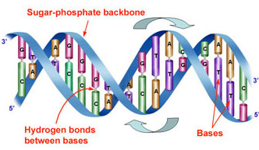
DNA – Deoxyribonucleic Acid
Housed in the nucleus of the cell, carries the instructions that allow cells to make proteins
Carries an individual’s genetic information
Composed of a sugar phosphate backbone from which four nitrogenous bases- adenine (A), guanine (G), cytosine (C), and thymine (T), protrude
Arranged in a double helix: two strands are held together by specific pairings between bases A – T pair and G – C pair
Notes:
The genetic material that carries the instructions that allow cells to make proteins
Composed of a sugar phosphate backbone from which four nitrogenous bases- adenine (A), guanine (G), cytosine (C), and thymine (T) protrude
Arranged in a double helix- two strands are held together by specific pairings between bases A – T pair and G – C pair

Slide 5
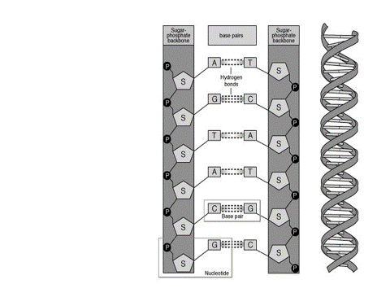
DNA – Deoxyribonucleic Acid

Slide 6
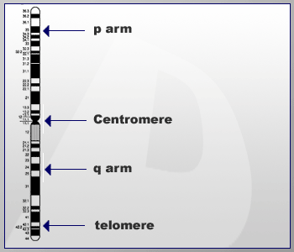
Chromosomes
Structures within the nucleus of a cell that carry the DNA and proteins
Each chromosome (chr) contains a single, long DNA molecule
Short arm: p arm (for the French word petit); long arm: q arm
Centromere: separates the two arms
Telomere: ends of a chromosome
chr occur in pairs (23 for humans and 39 for dogs)
p arm
Centromere
q arm
Telomere
Notes:
Now, in our modern wisdom, we use "allele" or "gene" instead of what Mendel
called "factors". There is a gene in the DNA of pea plants that controls plant
height (makes them either tall or short). One form of the gene (allele) codes for
tall, and the other allele for plant height codes for short. For abbreviations, we use the capital "T" for the dominant tall allele, and the lowercase "t" for the recessive short allele.

Slide 7
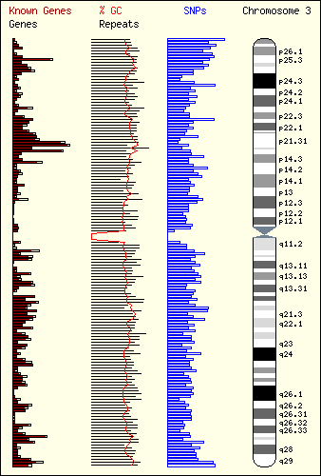
Chromosome 3
Telomere
p arm
On the p arm, numbering begins at the centromere and increase towards the telomere.
Centromere
On the q arm, numbering begins at the centromere and increase towards the telomere.
q arm
Telomere
Notes:
Now, in our modern wisdom, we use "allele" or "gene" instead of what Mendel
called "factors". There is a gene in the DNA of pea plants that controls plant
height (makes them either tall or short). One form of the gene (allele) codes for
tall, and the other allele for plant height codes for short. For abbreviations, we use the capital "T" for the dominant tall allele, and the lowercase "t" for the recessive short allele.

Slide 8
Table 1: Total Number of Chromosomes in the Cells
Ploidy
Name | Diploid Number
Human | 46
Monkey | 42
Dog | 78
Cat | 38
Mouse | 40
Frog | 26
Fruit Fly | 8
Corn | 20
Potato | 48
Green Algae | 20
Notes:
The genetic material that carries the instructions that allow cells to make proteins
Composed of a sugar phosphate backbone from which four nitrogenous bases- adenine (A), guanine (G), cytosine (C), and thymine (T) protrude
Arranged in a double helix- two strands are held together by specific pairings between bases A – T pair and G – C pair

Slide 9
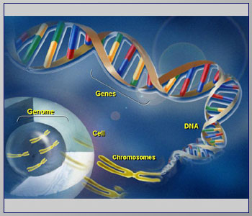
Genes
Are the unit of heredity
Are the instructions that make up a body’s blueprint
Code for the proteins and mRNA that determine virtually all of a person’s characteristics
Humans have between 20,000 and 30,000 genes
Genes occur at different sites or “loci” along a chr and occupy about 3% of the entire DNA

Slide 10
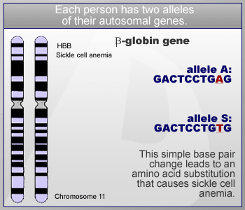
Alleles are alternative forms of a gene
Alleles are represented by different DNA codes
Humans have two copies (or alleles) of all of their autosomal genes
Homozygote: carries same alleles of a specific gene
Heterozygote: carries two different alleles of a specific gene
Genetic variation is caused by changes in the DNA code
allele G:
GACTCCTGAG
allele g:
GACTCCTGTG
e.g., different pea pod colors (green vs. yellow) are caused by different alleles for the same gene
Chromosome 11
Notes:
GENOTYPE = the genes present in the DNA of an organism. We will use a pair of
letters (ex: AA or Aa) to represent genotypes for one particular trait.
There are always two letters in the genotype because (as a result of sexual
reproduction) one code for the trait comes from mama organism & the other
comes from papa organism, so every offspring gets two codes (two letters).
Now, turns out there are three possible GENOTYPES - two big letters (like
“AA"), one of each (“Aa"), or two lowercase letters (“aa"). Since WE LOVE
VOCABULARY, each possible combo has a term for it When we have two capital or two lowercase letters in the GENOTYPE (ex: AA or aa) it's called HOMOZYGOUS ("homo" means "the same"). When the GENOTYPE is made up of one capital letter & one lowercase letter
(ex: Tt) it's called HETEROZYGOUS ("hetero" means "other"). Just to confuse
you, a heterozygous genotype can also be referred to as HYBRID. OK?
PHENOTYPE = how the trait physically shows-up in the organism. Wanna know
the simplest way to determine an organism's phenotype ? Look at it. Examples of
phenotypes: blue eyes, brown fur, striped fruit, yellow flowers.
ALLELES = alternative forms of the same gene. Alleles for a trait are located at corresponding positions on homologous chromosomes.

Slide 11
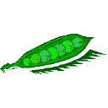
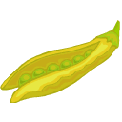
Phenotype and Genotype
Phenotype is the observable or measurable trait of the organism (physical, behavioral, or biochemical, etc.)
Genotype is the genetic identity of the organism across the genome. Here we show the genotypes at one particular diallelic locus (k(k+1)/2 for k alleles)
Phenotype
Genotype
X
GG or Gg
gg
X
Gg
Gg
GG
Gg
Gg
gg

Slide 12
Genotypes: Heterozygote and Homozygote
Heterozygote: individual with two different alleles at a locus (or gene)
Using the pea-pod color as an example, the Gg genotype is a heterozygote
Homozygote: individual with two identical alleles at a locus (or gene)
Using the pea-pod color as an example, the GG or gg genotypes are homozygotes
Notes:
Now, in our modern wisdom, we use "allele" or "gene" instead of what Mendel
called "factors". There is a gene in the DNA of pea plants that controls plant
height (makes them either tall or short). One form of the gene (allele) codes for
tall, and the other allele for plant height codes for short. For abbreviations, we use the capital "T" for the dominant tall allele, and the lowercase "t" for the recessive short allele.

Slide 13
Phenotype and Genotype
Phenotypic differences can be caused by allelic variation at:
Single locus = monogenic
Few loci = oligogenic
Many loci = polygenic
Any above + environment = multifactorial
Multifactorial - determined by multiple genetic and/or nongenetic factors; literally, “many factors”
The term polygenic is generally used to describe multiple factors that are exclusively genetic, though it can also be used in connection with a specific type of model involving multiple genetic factors with particular types of effects, e.g., the simple additive polygenic model (on a particular scale)

Slide 14
Human Genetic Variation
Primarily two types of genetic mutation events create all forms of variations:
Single base mutation which substitutes one nucleotide for another
-- Single Nucleotide Polymorphisms (SNP)
Insertion or deletion of one or more nucleotide(s)
--Tandem Repeat Polymorphisms
-- Insertion/Deletion Polymorphisms

Slide 15
Mutations
Allelic variations that are associated with disease or trait phenotypes are often called mutations
Mutations are the ultimate source of all genetic variation
Notes:
Now, in our modern wisdom, we use "allele" or "gene" instead of what Mendel
called "factors". There is a gene in the DNA of pea plants that controls plant
height (makes them either tall or short). One form of the gene (allele) codes for
tall, and the other allele for plant height codes for short. For abbreviations, we use the capital "T" for the dominant tall allele, and the lowercase "t" for the recessive short allele.

Slide 16
Polymorphism
Implies genetic variation at a designated locus
A locus that is polymorphic has at least two alternative alleles
More specific definition (not universally accepted)- the existence of two or more genetic variants (alleles, sequence variants, chromosomal structure variants) at significant frequencies in the population

Slide 17
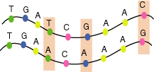
Single Nucleotide Polymorphisms (SNPs)
Single nucleotide polymorphisms ( SNPs) are DNA sequence variations that occur when a single nucleotide (A,T,C,or G) in the genome sequence is altered
For a variation to be considered a SNP, it usually occurs in at least 1% of the population

Slide 18
SNPs and Mutations
Terminology for variation at a single nucleotide position is defined by allele frequency(proportion).
A single base change, occurring in a population at a frequency of >1% is termed a single nucleotide polymorphism (SNP).
When a single base change occurs at <1% it is considered to be a mutation.

Slide 19
Tandem Repeat Polymorphisms
Tandem repeats or variable number of tandem repeats (VNTR)
are a very common class of polymorphism, consisting of variable length
of sequence motifs that are repeated in tandem in a variable copy number.
VNTRs are subdivided into two subgroups based on the size of the tandem
repeat units.
Microsatellites or Short Tandem Repeat (STR)
repeat unit: 1-6 (dinucleotide repeat: CACACACACACA)
Minisatellites
repeat unit: 14-100
Examples:
Spinocerebellar ataxia Type10 (SCA10) (OMIM:603516) is caused
by largest tandem repeat seen in human genome. Normal population
has 10-22 ATTCT repeats in intron 9 of SCA10 gene; where as SCA10
patients have 800-4500 repeat units, which causes the disease allele
up to 22.5 kb larger than the normal one.
Fragile X syndrome: caused by a CGG repeat in the coding region of the
FMR1 gene. Normal: <40 repeats. Premutation: <200 repeats.
Affected: >200 repeats.

Slide 20
Short Tandem Repeats (STRs)
AATG
7 repeats
8 repeats
The repeat region is variable between samples while the flanking regions where PCR primers bind are constant

Slide 21
STR / Microsatellite
STRs consist of small simple-sequence (e.g. di-, tri-, or tetranucleotide) repeats, which can be detected by PCR with primers
Typically repeat a total of~5 to 30 times
Most commonly is (CA) repeat
Many alleles, more informative than others
Distributed throughout genome

Slide 22
STR / Microsatellite, cont.
D15S650 (D = DNA, 15 = chromosome 15, S = single copy, 650 = 650th system described on chr 15)
Alleles indicate the type of repeat, i.e. alleles 136, 139, 142 = trinucleotide repeat
Problem – high mutation rate 10 ⁻² to 10 ⁻⁶ events per locus per generation
Problem – technical genotyping problems common
Used less often nowadays as genetic markers

Slide 23
Two Main Types of Microsatellites . . .
Tetranucleotide repeat:
Paternal
allele
AACTAACTAACTAACT
TTGATTGATTGATTGA
4 repeats
Maternal
allele
AACTAACT
TTGATTGA
2 repeats
Dinucleotide repeat:
Paternal
allele
CACACACACACACACA
GTGTGTGTGTGTGTGT
8 repeats
Maternal
allele
CACACA
GTGTGT
3 repeats

Slide 24
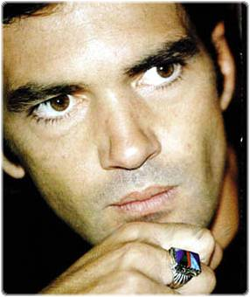
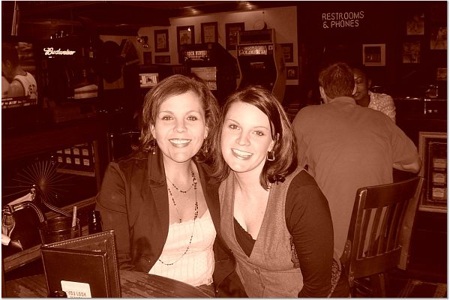
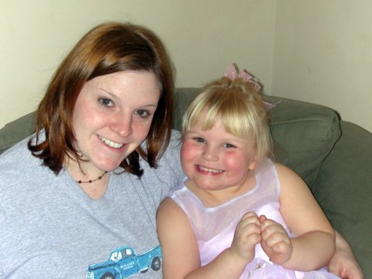
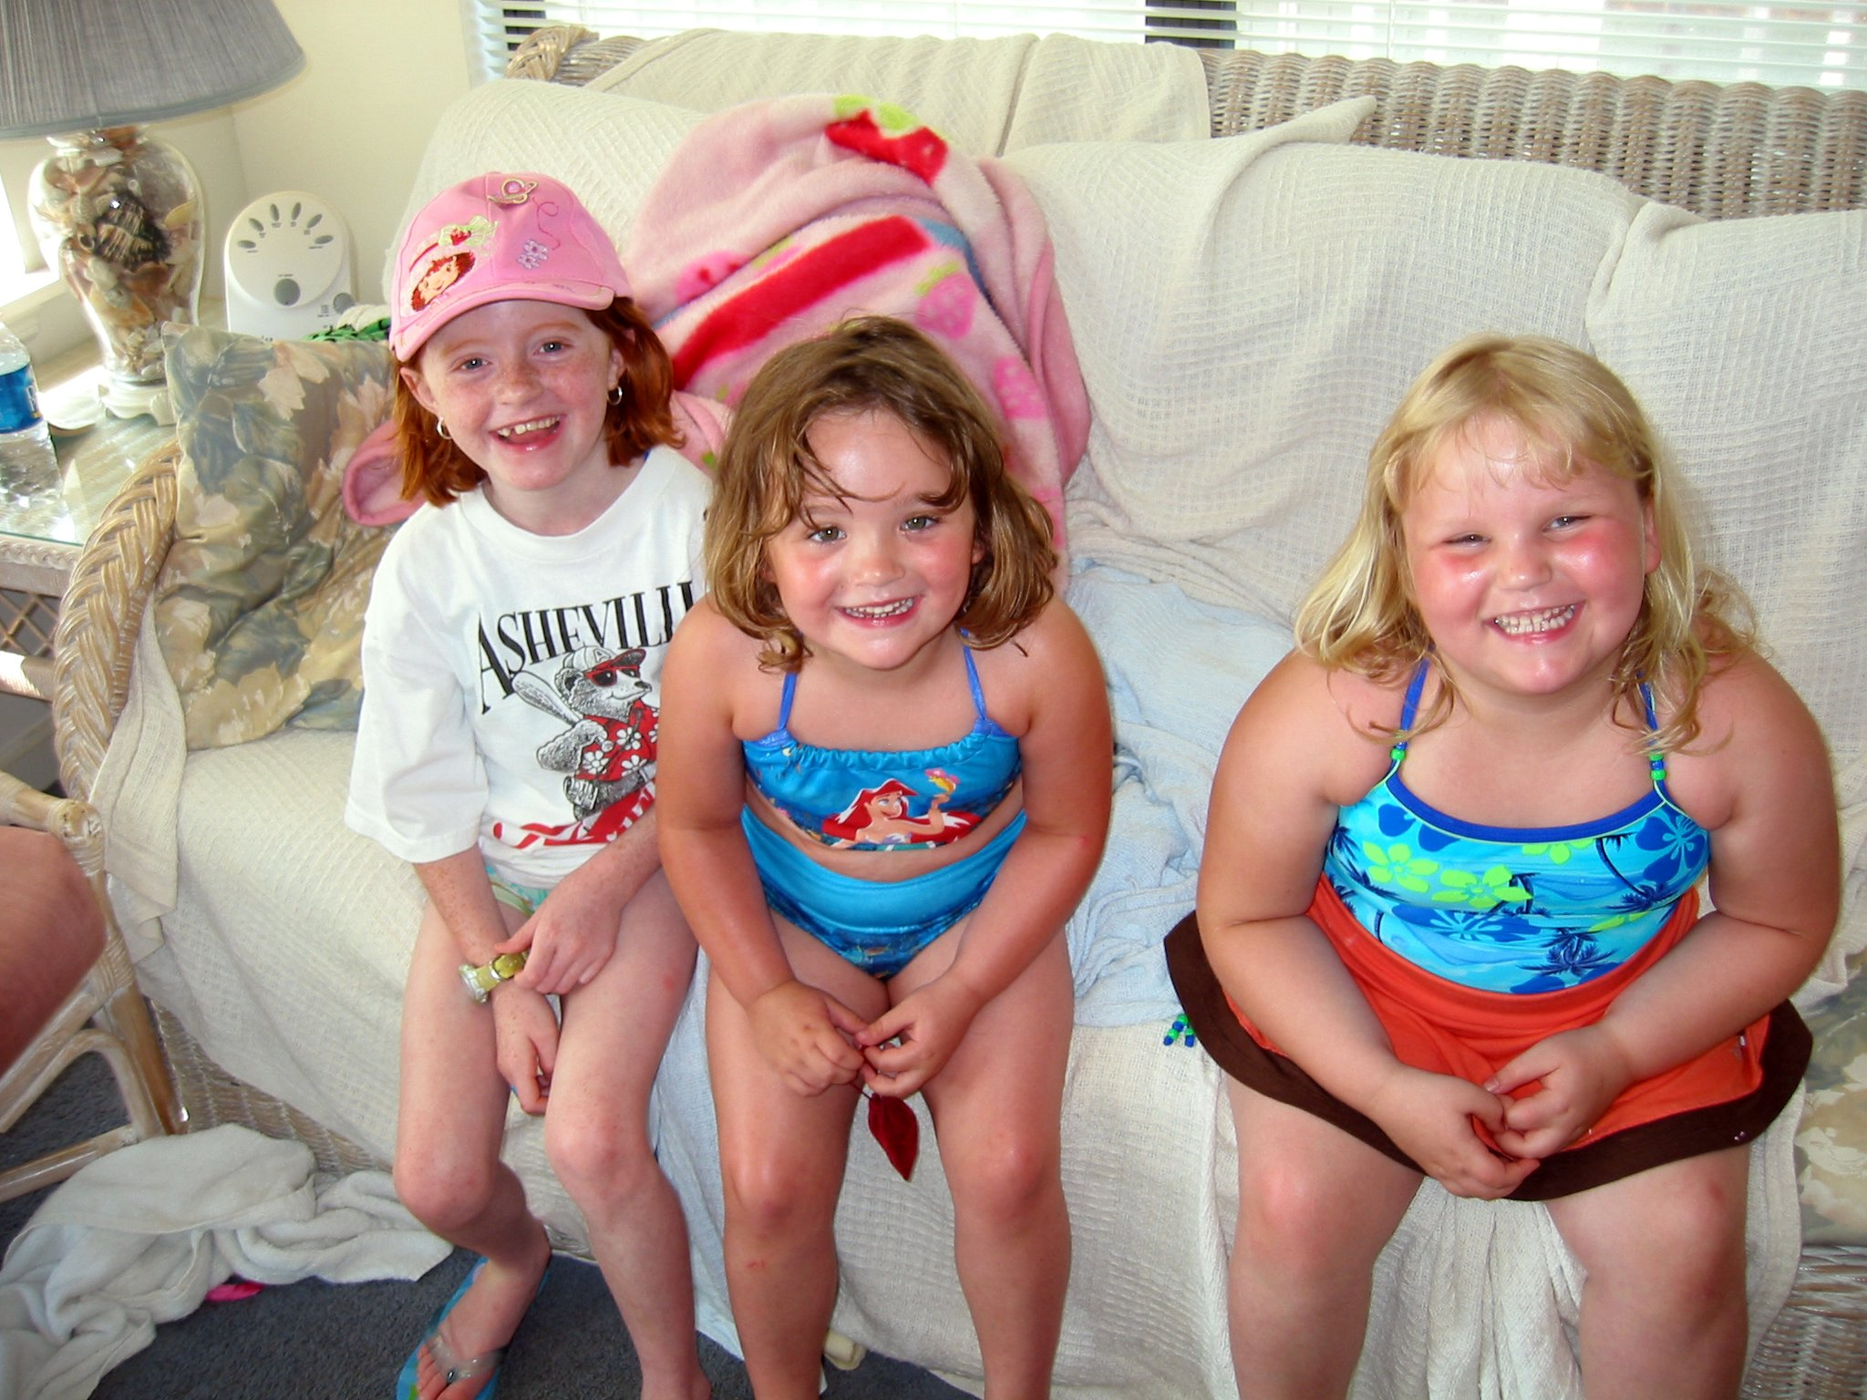
Use for microsatellites:
Paternity Testing
6
4
5
3
9
5
5
3

Slide 25
Human genomes vary at multi-kilobase as well as single-nucleotide scales (Lafrate et al., Nature Genetics 2004; Sebat et al., Science 2004) Defined as variation in copy number of genomic segments 1-500 kb in size
Copy Number Variants

Slide 26
Common misconceptions about copy number variation
Copy number variation is vast -- large (>50 kb) CNVs reported to influence 15-18% of the human genome, greatly exceeding SNP variation
Redon et al., Nature 2007
Database of Genomic Variants
CNVs are mostly rare and reflect recent, recurring mutations
Jakobsson et al., Nature 2008

Slide 27
Common misconceptions about copy number variation- McCarroll et al.
Copy number variation is vast -- large (>50 kb) CNVs reported to influence 15-18% of the human genome, greatly exceeding SNP variation
Our finding: Any two individuals differ at less than 0.3% of their genomes due to large CNVs
CNVs are mostly rare and reflect recent, recurring mutations
Our finding: More than 90% of copy-number variation among normal individuals is due to a limited set of common polymorphisms that reflect ancestral mutations
Also– recent evidence shows that ~60% of CNV’s are highly correlated with known SNP variation.

Slide 28
Human Genetic Variation:
Genetic Markers
Used to mark or “track” sections of DNA from parent to child or to compare sections of DNA from individual to individual
A gene or other segment of DNA with an identifiable physical location on a chromosome and whose inheritance can be followed
A variable DNA sequence that can be localized to a single genomic locus
Can identify differences between individuals and between homologous chromosomes in an individual
Genetic markers have a pivotal role in gene mapping
Sequence variations at genetic markers are not usually functional, (but may be correlated with functional variants)

Slide 29
Genetic Markers: Desirable Qualities
Heritable
Low mutation frequency (so it will be passed from generation to generation without alteration)
Codominant inheritance (all genotypes are distinguishable)
Hardy Weinberg Equilibrium (HWE)
Polymorphic (the more variants and the higher the proportion of heterozygotes there are, the better)

Slide 30
Mendelian Genetics

Slide 31
Pedigrees are Pictorial Representations of the Family Tree
The biological relationships are indicated in the symbols and how they are drawn
Each generation is represented by a row
Horizontal lines join individuals who have children together
Vertical lines connect their children to them
AA
Aa
Aa
AA
AA
Aa
Notes:
Now, in our modern wisdom, we use "allele" or "gene" instead of what Mendel
called "factors". There is a gene in the DNA of pea plants that controls plant
height (makes them either tall or short). One form of the gene (allele) codes for
tall, and the other allele for plant height codes for short. For abbreviations, we use the capital "T" for the dominant tall allele, and the lowercase "t" for the recessive short allele.

Slide 32
Pedigree Construction: Symbols
= Female
= Female carrier for
X-linked trait
= Male
= Unknown sex
= Affected Female, Male
= Deceased Male

Slide 33
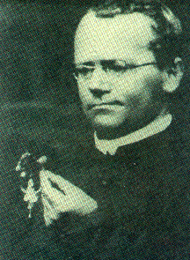
Johann Gregor Mendel (1822-1884)
Augustinian monk working in country presently known as Czech Republic
Studied plant hybridization for 8 years
Cross pollination of common varieties of sweet pea (color, shape, size, and form of sea pod)
Lucky he chose traits of simple inheritance, each on their own chromosome

Slide 34
Mendel (1822-1884)
Hypothesized that an organism’s characteristics were inherited as discrete units or elements and not through blending of parental traits
In 1864 began to disseminate findings
Mendel’s work was unrecognized during his lifetime
In 1900 three independent botanical researchers uncovered his work (deVries, Correns, and Tschermak)

Slide 35
Example – ABO Blood Group
Based on antigens on the surface of red blood cells
Chromosome 9.
Alleles: A, B, O A = A antigen; B = B antigen; O=neither
Genotype Phenotype (blood group, monogenic)
AA, AO A
BB, BO B
AB AB
OO O
Genotypes consisting of two copies of the same allele are homozygous. Examples AA, BB, OO
Genotypes consisting of two different alleles are heterozygous. Examples: AB, AO, BO
Notes:
35

Slide 36
Dominant - Recessive
When a heterozygous genotype has distinguishable phenotype from both homozygous genotypes, the alleles are codominant
- Example: ABO Blood Group; A and B are codominant - (AB genotype results in unique phenotype)
When a heterozygous genotype results in the same phenotype as a corresponding homozygous genotype, the allele is dominant.
- Example:
- AA, AO result in blood group A.
- BB, BO result in blood group B.
- A and B are dominant to O.
- Equivalently, O is recessive to A and B.

Slide 37
Mendel’s Law Continued
Heterozygous cross: MNxMN
Example: MN blood group
(another codominant locus)
maternal→ paternal | M | N
M | MM | MN
N | MN | NN
Notes:
37

Slide 38
Mendel’s Laws
Law of Independent Segregation
Inheritance is particulate
Law of Independent Assortment
Genes sort independently
Meiosis (specialized cell division that takes place when sex cells --gametes -- are produced ) is the basis for Mendel’s Laws of Inheritance
Mendel’s laws are probability models
Notes:
The Law of Dominance
In a cross of parents that are pure for contrasting traits, only one form of the trait will appear in the next generation. Offspring that are hybrid for a trait will have only the dominant trait in the phenotype.
Law of Independent Segregation
Inheritance is particulate
Law of Independent Assortment
Genes sort independently
Now, notice in that very brief description of his work that the words
"chromosomes" or "genes" are nowhere to be found. That is because the role ofthese things in relation to inheritance & heredity had not been discovered yet.
What makes Mendel's contributions so impressive is that he described the basic patterns of inheritance before the mechanism for inheritance (namely genes) was even discovered.

Slide 39
Mendel’s Law of Independent Segregation
Inheritance is particulate
During the formation of gametes (eggs or sperm), the two alleles responsible for a trait separate from each other.
Notes:
The Law of Segregation Goes like so: During the formation of gametes (eggs or sperm), the two alleles
responsible for a trait separate from each other. Alleles for a trait are then
"recombined" at fertilization, producing the genotype for the traits of the
offspring.

Slide 40
F1 Offspring
 | Parents | F1 Offspring
Genotype = | GG * gg | 100% Gg
Phenotype = | Green * Yellow | 100% Green
Notes:
So, he takes two of the "F1" generation (which are tall) & crosses them.
Phenotype = Tall
Genotype = Hetergygous (Aa)

Slide 41
Punnett Squares
Green Pod Parent (GG)
Alleles for
Yellow Parent
Yellow Pod Parent (gg)
G
G
Alleles for Green Pods
g
Gg
Gg
g
Gg
Gg
Notes:
Recall that he "discovered" this law by crossing a pure tall pea plant & a pure short pea plant. In symbols,
that cross looks like this:
Parents (P): TT x tt
where T = the dominant allele for tall stems
& t = recessive allele for short stems

Slide 42
Mendel’s Law of Independent Segregation
Green Pod Parent (Gg)
Green Pod Parent (Gg)
Note: Mendel’s laws are probability models– not deterministic.
GgxGg→ each offspring has a ¼ chance of being yellow. Or: if you had a zillion pods, you would expect ¼ to be yellow, on average.
G
g
G
Green
GG
Green
Gg
g
Green
Gg
Yellow
gg
Notes:
I would think that he is figuring that he's gonna get all tall again (since tall is dominant). But no! Low & behold he gets some short plants from this cross! His new batch of pea plants (the "F2" generation) is about 3/4 tall & 1/4 short.
Greg ol' boy, the parent plants for this cross each have one tall factor
that dominates the short factor & causes them to grow tall. To get short
plants from these parents, the tall & short factors must separate,
otherwise a plant with just short factors couldn't be produced. The
factors must SEGREGATE themselves somewhere between the
production of sex cells & fertilization.“
Using the Punnet Square, we model this "Law of Segregation" every time. When you "split" the genotype letters & put one above each column & one in front of
each row, you have SEGREGATED the alleles
for a specific trait. In real life this happens
during a process of cell division called
"MEIOSIS". Meiosis leads to the production
of gametes (sex cells), which are either eggs
or sperm. Sometimes the term
"GAMETOGENESIS" is used instead of
meiosis.

Slide 43
Mendel’s Law of Independent Segregation
X
Parent Pea Plants (Two Members of F1 Generation)
Genotypes: Gg x Gg Phenotypes: green x green
X
Offspring (F2 Generation)
Genotypes: 25% GG, 50% Gg, 25% gg
Phenotypes: 75% green , 25% yellow

Slide 44
Mendel’s Laws, cont.
Law of Independent Segregation
Inheritance is particulate
Law of Independent Assortment
Genes sort independently
Meiosis is the basis for Mendel’s Laws of Inheritance
Notes:
The Law of Dominance
In a cross of parents that are pure for contrasting traits, only one form of the trait will appear in the next generation. Offspring that are hybrid for a trait will have only the dominant trait in the phenotype.
Law of Independent Segregation
Inheritance is particulate
Law of Independent Assortment
Genes sort independently
Now, notice in that very brief description of his work that the words
"chromosomes" or "genes" are nowhere to be found. That is because the role ofthese things in relation to inheritance & heredity had not been discovered yet.
What makes Mendel's contributions so impressive is that he described the basic patterns of inheritance before the mechanism for inheritance (namely genes) was even discovered.

Slide 45
Mendel’s Law of Independent Assortment
Alleles for different traits sort independently
Alleles for different traits are distributed to sex cells (& offspring) independently of one another
Notes:
The Law of Independent Assortment
Alleles for different traits are distributed to sex cells (& offspring) independently of
one another.
OK. So far we've been dealing with one trait at a time. For example, height (tall or
short), seed shape (round or wrinkled), pod color (green or yellow), etc. Mendel
noticed during all his work that the height of the plant and the shape of the seeds
and the color of the pods had no impact on one another. In other words, being tall
didn't automatically mean the plants had to have green pods, nor did green pods
have to be filled only with wrinkled seeds, the different traits seem to be inherited
INDEPENDENTLY.
Please note my emphasis on the word "different". Nine times out of ten, in a
question involving two different traits, your answer will be "independent
assortment".

Slide 46
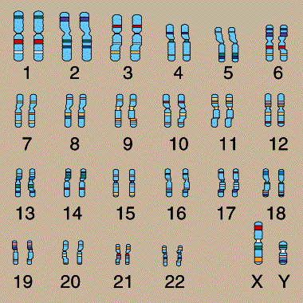
Mendel’s Law of Independent Assortment
Notice that we are dealing with two different traits: (1) seed size [ tall (AA, Aa) or short (aa) ] & (2) pod color [ green (GG, Gg) or yellow (gg) ], inherited on different chromosomes
Gene for seed size on chromosome 1
Gene for pod color on chromosome 2
Notes:
Notice that we are dealing with two different traits: (1) seed size (tall (AA, Aa) or short (aa)) & (2) pod color (green (GG, Gg) or yellow (gg)), inherited on different chromosomes

Slide 47
G
Mendel’s Law of Independent Assortment
a
A
g
Gene for seed size on chromosome 1
Gene for pod color on chromosome 2
Notes:
Notice that we are dealing with two different traits: (1) seed size (tall (AA, Aa) or short (aa)) & (2) pod color (green (GG, Gg) or yellow (gg)), inherited on different chromosomes

Slide 48
Mendel’s Law of Independent Assortment
F1 cross: GgAa x GgAa
Possible Gametes for two traits sorting independently:
GA
gA
Ga
ga
GA, Ga, gA, ga
GA
GGAA
Tall
GgAA
Tall
GGAa
Tall
GgAa
Tall
gA
GgAA
Tall
ggAA
Tall
GgAa Tall
ggAa
Tall
9 Green / Tall
3 Green / Short
3 Yellow / Tall
1 Yellow / Short
Ga
GGAa Tall
GgAa Tall
GGaa
Short
Ggaa
Short
ga
GgAa
Tall
ggAa
Tall
Ggaa
Short
ggaa
Short
Notes:
The results from a dihybrid cross are always the same:
9/16 boxes (offspring) show dominant phenotype for both traits (tall & green),
3/16 show dominant phenotype for first trait & recessive for second (tall & yellow),
3/16 show recessive phenotype for first trait & dominant form for second (short &
green), &
1/16 show recessive form of both traits (short & yellow).

Slide 49
Mendel’s Law of Independent Assortment
The results from a dihybrid cross are always the same:
9/16 boxes (offspring) show dominant phenotype for both traits (tall & green)
3/16 show dominant phenotype for first trait & recessive for second (tall & yellow)
3/16 show recessive phenotype for first trait & dominant form for second (short & green)
1/16 show recessive form of both traits (short & yellow)
Notes:
The results from a dihybrid cross are always the same:
9/16 boxes (offspring) show dominant phenotype for both traits (tall & green),
3/16 show dominant phenotype for first trait & recessive for second (tall & yellow),
3/16 show recessive phenotype for first trait & dominant form for second (short &
green), &
1/16 show recessive form of both traits (short & yellow).
The different traits do not influence the inheritance of each
other. They are inherited INDEPENDENTLY.

Slide 50
Mendel’s Law Continued
Mendel II allows us to extend this sort of calculation to multiple (unlinked) loci
Example: MN and ABO Blood Group
Dad Mom
MN AB x MN AB
|
?
Pr(MM AB) = Pr(MM)xPr(AB) = (1/4)x(1/2) = 1/8
Pr(MM BB) = Pr(MM)xPr(BB) = (1/2)x(1/2) = ¼
i.e., since the MN and ABO blood group genes are transmitted independently of one another, we can simply multiply the individual probabilities to obtain joint probabilities.
Notes:
50

Slide 51
Mendelian Modes of Inheritance
Autosomal Dominant
Autosomal Recessive
X-linked Recessive
X-linked Dominant
Y-linked
Inheritance patterns describe how a disease is transmitted in families
These patterns help to predict the recurrence risk for relatives

Slide 52
Autosomal Dominant Inheritance
A single copy of an allele is sufficient to cause expression of a trait
Phenotype is expressed in the heterozygote and homozygote
Affected individuals have at least one affected parent
In a population, males and females are equally at risk
Each pregnancy has a 50% risk of inheriting the gene
Aa
aa
Aa
aa
aa
Aa
EPI 743, 01/17/2008

Slide 53
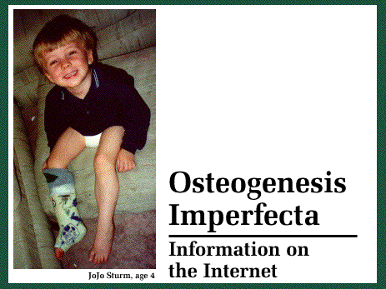
Example: Osteogensis Imperfecta (Type1)
Mutations affecting a protein chain [alpha ₁(I)] lead to deficient production of type I collagen
Marked by extreme fragility of bones

Slide 54
Other Examples of “Common” Autosomal Dominant Traits
Familial hypercholesterolemia -- 1/500
Homozygote = 1/1,000,000 (more severe)
Results in elevated LDL cholesterol and increased risk of CAD
Huntington’s disease ~ 1/10,000
Associated with neuronal cell death and dementia
Ehlers-Danlos variants ~1/5,000-1/10,000
Associated with a proneness to spontaneous rupture of bowel or large arteries
Achondroplasia ~1/12,000
most frequent form of short-limb dwarfism
EPI 743, 01/17/2008
Notes:
FH -- Elevated LDL cholesterol increased risk of CAD - primary cause LDLR on chrm 19
Huntingtons – neuronal cell death and dementia (age of onset mean 30-40 years) - The disease is associated with increases in the length of a CAG triplet repeat present in a gene called 'huntingtin' located on chromosome 4p16.3
Ehlers-Danlos = a proneness to spontaneous rupture of bowel or large arteries although many variants-- a defect in the gene for type III collagen (2q31)
Achondroplasia-- most frequent form of short-limb dwarfism --caused by mutation in the fibroblast growth factor receptor-3 gene 4p16.3 (many due to new mutations)
http://www.siue.edu/~smccomm/220/Human.ppt

Slide 55
Autosomal Recessive
Phenotype expressed in homozygote
Parents are heterozygous and “normal”
Males and females equally at risk
Two carriers have a 25% risk of producing an affected child
Many ethnic groups have clusters of disease
New mutations very unusual
Aa
Aa
aa
Aa
Aa
AA
EPI 743, 01/17/2008

Slide 56
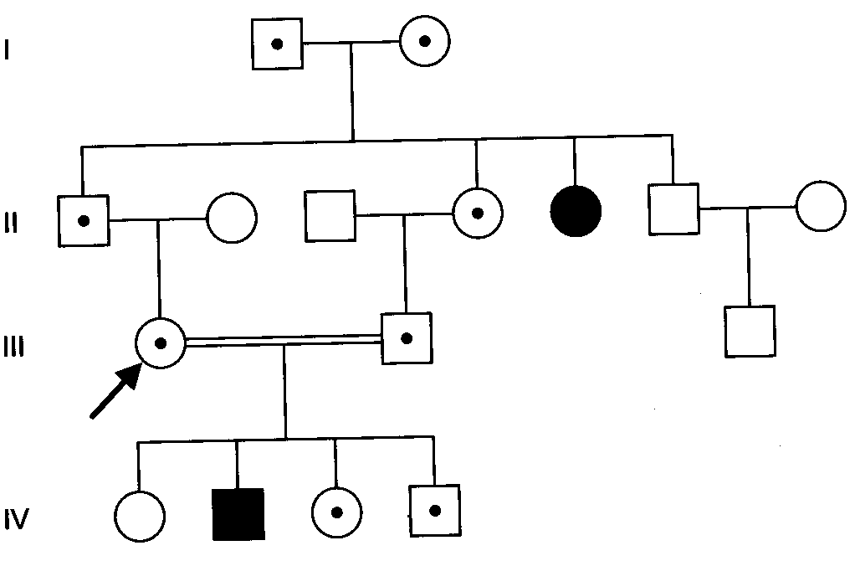
Autosomal Recessive
EPI 743, 01/17/2008

Slide 57
Example: Oculocutaneous Albinism (OCA)
A child affected with OCA Type 1 is usually homozygous for a mutation in the gene encoding tyrosinase, which is an enzyme necessary for the production of melanin
Characterized by total or nearly total absence of cutaneous and ocular pigmentation

Slide 58
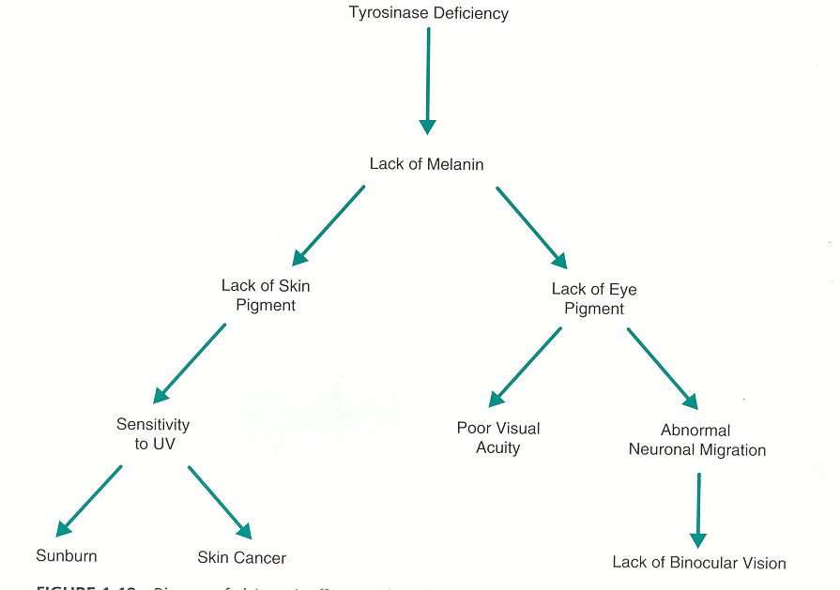
Pleiotropic effects resulting from tyrosinase deficiency in albinism
Pleiotropic gene- A gene that causes a number of distinct phenotypic effects
EPI 743, 01/17/2008

Slide 59
Other Common Autosomal Recessive Diseases
Cystic fibrosis -- ~1/3,600 Whites
Condition causing abnormally thick, sticky secretions in the glands that produce mucus, tears, sweat, saliva and digestive juices
Gaucher’s disease -- 1/1,000 (Ashkenazi Jews) 1/50,000
Associated with hematological abnormalitie with hypersplenism, bone lesions, and skin pigmentation
PKU (Maternal PKU) -- 1/20,000
Resulting from a deficiency of phenylalanine hydroxylase and characterized by mental retardation
EPI 743, 01/17/2008
Notes:
CF -- caused by mutations in the cystic fibrosis conductance regulator gene 7q31.2 many mutations
SCA – mutant beta globin gene
Gaucher disease is caused by mutation in the gene encoding acid-beta glucosidase
PKU - deficiency of phenylalanine hydroxylase
The occurrence of mental retardation in the offspring of homozygous mothers is an example of a genetic disease based on the genotype of the mother. Kerr et al. (1968) demonstrated 'fetal PKU' by administering large amounts of phenylalanine to mother monkeys. The offspring had reduced learning ability. They pointed out that the damage is aggravated by the normal placental process which functions to maintain higher levels of amino acids in the fetus than in the mother

Slide 60
X-Linked Recessive Inheritance
Primarily affects males
Carrier females pass trait to half their sons and carrier status to half their daughters
Phenotype generally expressed in hemizygous individuals
Affected males are at risk of transmitting the disorder to their grandsons through their obligate carrier daughters
Mothers of affected males are heterozygous
No male to male transmission
XX_{c}
XY
XX
XY
XX_{c}
X_{c}Y
EPI 743, 01/17/2008

Slide 61
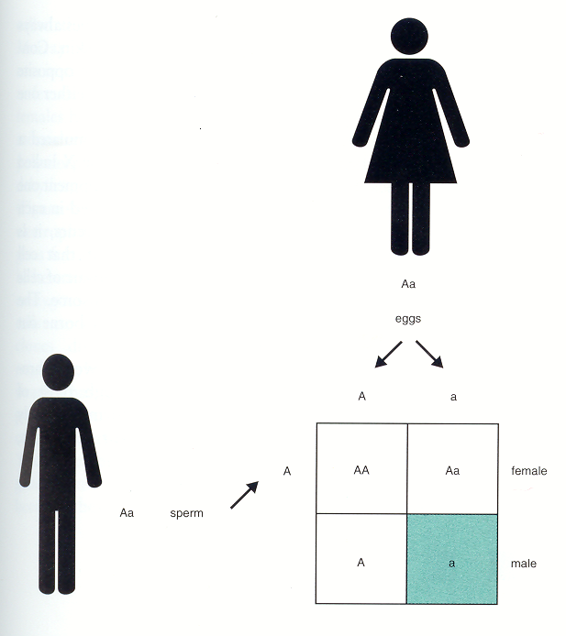
Example: Duchenne Muscular Dystrophy
Characterized by progressive loss of muscle strength
Caused by a mutation in the gene that produces an important muscle protein, dystrophin
Affected males are hemizygous for the mutation
Affected females are homozygous (affected) for the mutation
eggs
X
X_{c}
X_{c}
X_{c}X
X_{c}X_{c}
sperm
Y
X Y
X_{c}Y
EPI 743, 01/17/2008

Slide 62
Other Common X-linked Recessive Diseases
Hemophilia A and B ~1/10,000
Bleeding disorder caused by a deficiency in the activity of coagulation factor VIII or IX
Some carriers bleed, frequency 1/10,000
G-6-PD deficiency -- ~1/500 African Americans
An enzyme deficiency of the red blood cells leading to hemolytic anemia
Ocular Albinism -- ~ 1/180,000
Ethnicity dependent ?
Eyes lack melanin pigment, while the skin and hair show normal or near-normal coloration
EPI 743, 01/17/2008

Slide 63
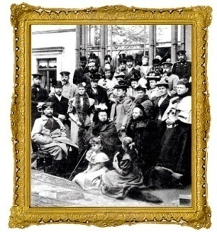
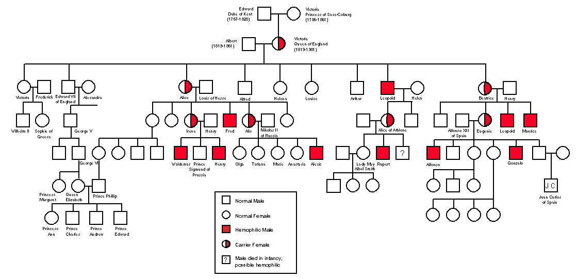
Pedigree of the Royal Family (Queen Victoria): Hemophilia
EPI 743, 01/17/2008

Slide 64
X-linked Dominant Inheritance
Affected mothers have a 50% chance of producing affected children
All daughters from affected males are affected
Affects either sex, but far more females than males
There are frequently an excess of live born females (affected male mortality)
Sons of affected males never inherit the disorder
Affected females can transmit the disorder to offspring of both sexes
EPI 743, 01/17/2008

Slide 65
X-linked Dominant Diseases
Charcot-Marie-Tooth Disease (CMT)
Associated with weakness and atrophy of muscles of hands and lower legs, with foot deformities and some loss of sensation in feet
Coffin-Lowry Syndrome
(Soft hand syndrome) associated with mental and somatic retardation & large soft hands, and various bone abnormalities
Hypophosphatemia -- ~1 in 20,000 people
Associated with Vitamin D Resistant Rickets
EPI 743, 01/17/2008

Slide 66
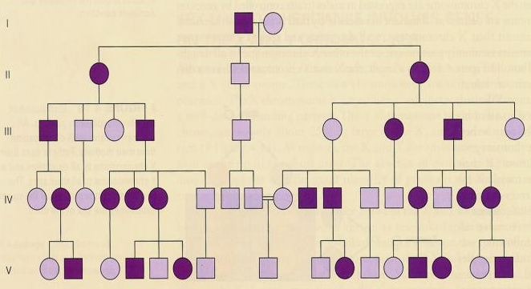
Hypophosphatemia: X-linked Dominant Trait
EPI 743, 01/17/2008

Slide 67
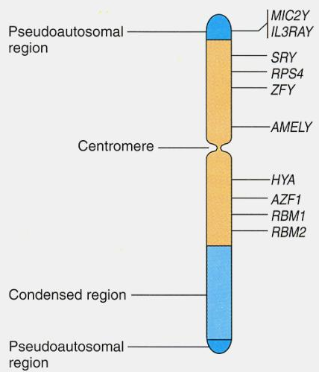
Y-Linked Traits
Hemizygous – always expressed
Phenotype expressed in males (no affected females)
NO daughters of affected father affected
Affected sons have affected fathers
ALL sons of affected father will be affected
If you have it and your “son” doesn’t, then he isn’t yours!
Very rare - only ~ 3 dozen known
EPI 743, 01/17/2008

Slide 68
Idealized Y-Linked Pedigree
XX
XY
XX
XY
XX
XY
EPI 743, 01/17/2008

Slide 69
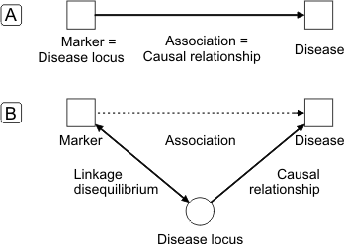
Genetic Association
Genetic association can be defined as the association between an allele at a particular genetic marker (locus) and a phenotype (disease).
The association is observed between an allele and a disease, can be shown and interpreted in the following figure
Fig. 1: Causal models for genetic association. In direct association (A), the marker locus is identical to the disease locus. In indirect association (B), the marker locus is in linkage disequilibrium with the disease locus.
Notes:
The genetic material that carries the instructions that allow cells to make proteins
Composed of a sugar phosphate backbone from which four nitrogenous bases- adenine (A), guanine (G), cytosine (C), and thymine (T) protrude
Arranged in a double helix- two strands are held together by specific pairings between bases A – T pair and G – C pair

Slide 70
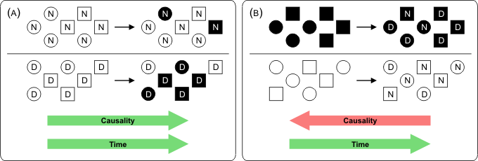
Study Designs for Association
To study genetic association, a broad distinction can be made between studies utilizing data from unrelated individuals and those based on family data. If unrelated individuals are recruited for the study, it will strongly resemble classical epidemiological studies. Hence, similar study designs can be employed, two of which are depicted in the figure below.
Fig. 2: Study designs for association analysis with unrelated individuals. (A) Cohort study recruiting probands without knowledge of their disease status. (B) Case-control study recruiting probands according to their disease status.
Notes:
The genetic material that carries the instructions that allow cells to make proteins
Composed of a sugar phosphate backbone from which four nitrogenous bases- adenine (A), guanine (G), cytosine (C), and thymine (T) protrude
Arranged in a double helix- two strands are held together by specific pairings between bases A – T pair and G – C pair

Slide 71
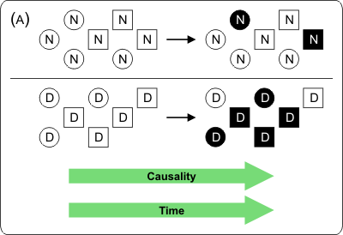
Study Designs for Association
Cohort Study: a sample of probands - a cohort - is recruited without knowledge of their disease status, ideally prior to anyone developing the disease.
Fig. 3: Study design (A) for association analysis with unrelated individuals: Cohort study recruiting probands without knowledge of their disease status.
Notes:
The genetic material that carries the instructions that allow cells to make proteins
Composed of a sugar phosphate backbone from which four nitrogenous bases- adenine (A), guanine (G), cytosine (C), and thymine (T) protrude
Arranged in a double helix- two strands are held together by specific pairings between bases A – T pair and G – C pair

Slide 72
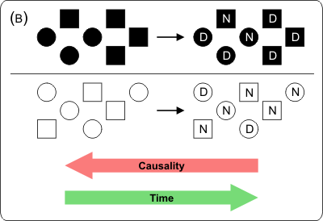
Study Designs for Association
Case-Control Study: a sample of affected and unaffected individuals, the cases and the controls, are recruited. These are then analyzed with respect to their genetic status.
Fig. 4: Study design (B) for association analysis with unrelated individuals: Case-control study recruiting probands according to their disease status.
Notes:
The genetic material that carries the instructions that allow cells to make proteins
Composed of a sugar phosphate backbone from which four nitrogenous bases- adenine (A), guanine (G), cytosine (C), and thymine (T) protrude
Arranged in a double helix- two strands are held together by specific pairings between bases A – T pair and G – C pair

